Slide 1
Diabetes. New frontiers and pharmacology
ANGELO AVOGARO
SENIOR SCIENTIST.
University of Padova

Slide 2
Angelo Avogaro conflicts of interest:
Novo Nordisk
Amgen
Astrazeneca
Bayer
Boehringher-Ingelheim
GSK
Servier
Lilly
Sanofi
Merck Sharp & Dohme
Menarini Diagnostici
Bruno Farmaceutici

Slide 3
Diabetes mellitus is a significant global health concern
Recent advancements in pharmacology are changing approaches to treatment, leading to better patient outcomes and enhanced quality of life.

Slide 4
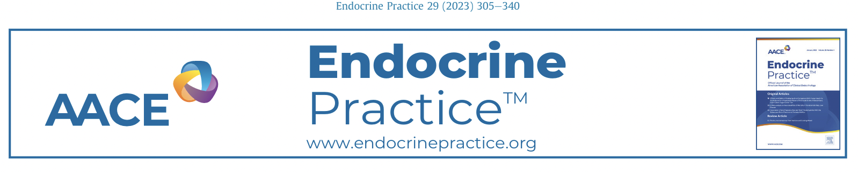
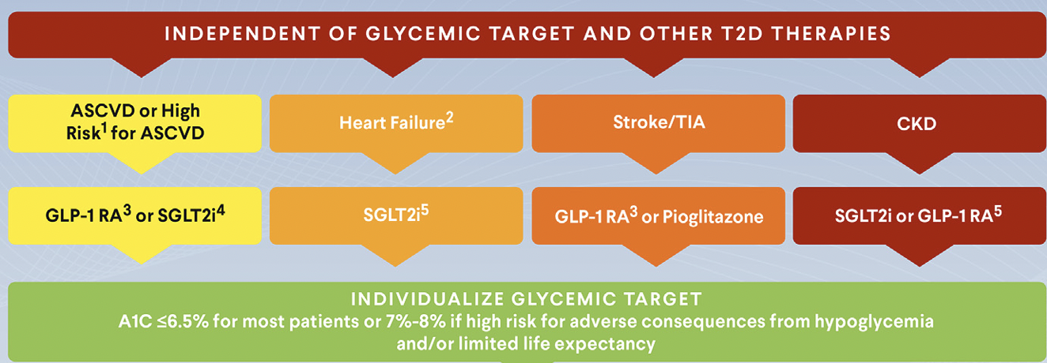

Slide 5
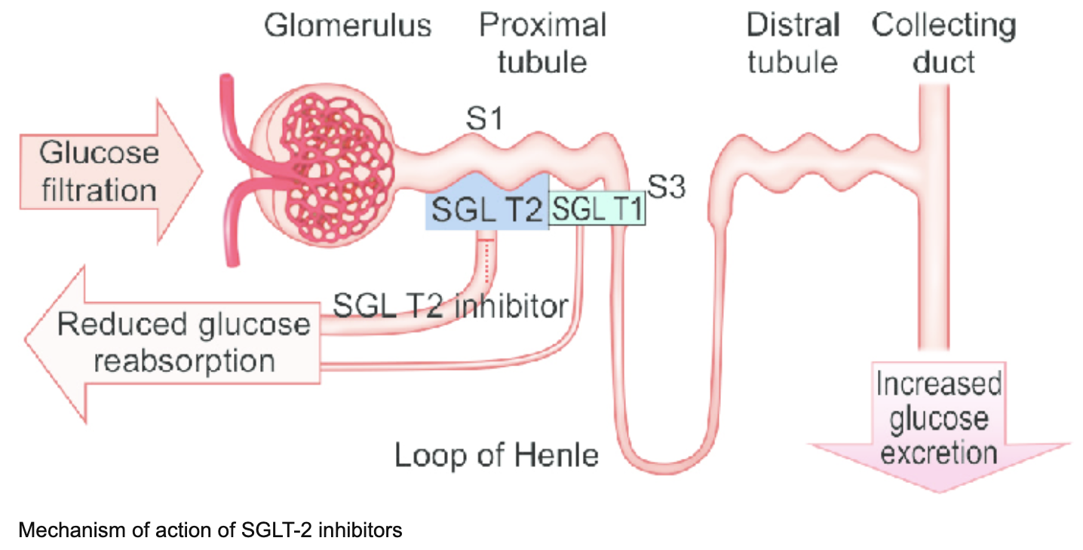
SGLT2i MoA
Kumar et al. 2016

Slide 6
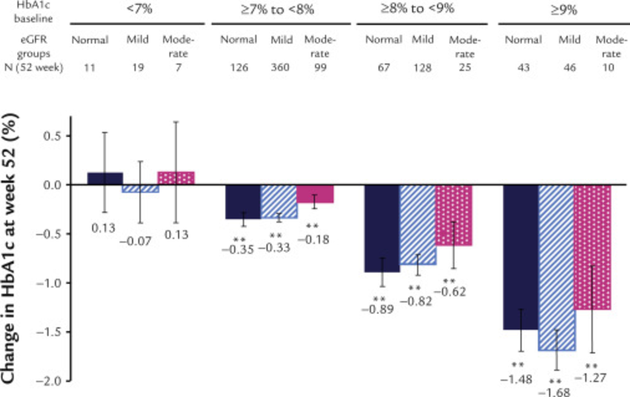
SGLT2i effects on HbA1c stratified by renal function
Haneda et al. 2015

Slide 7
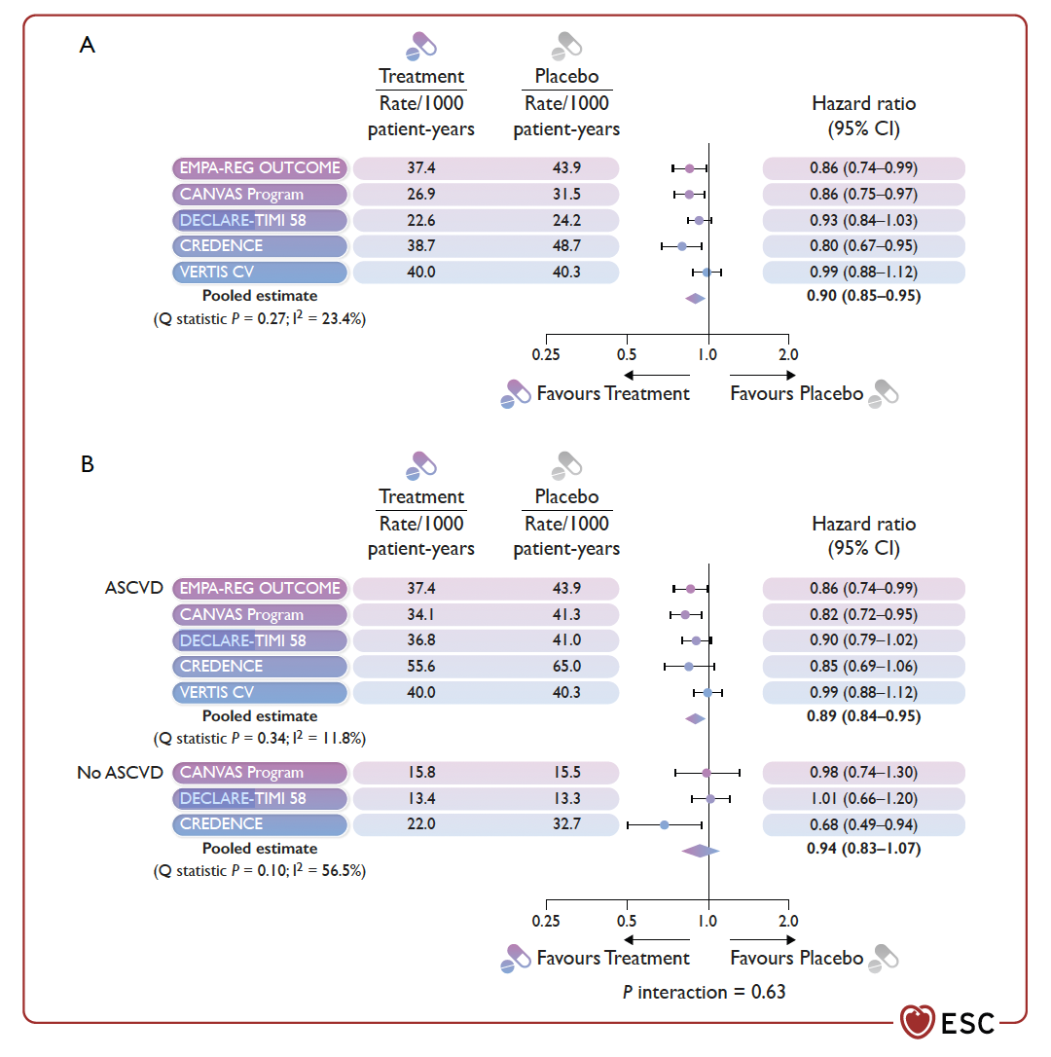
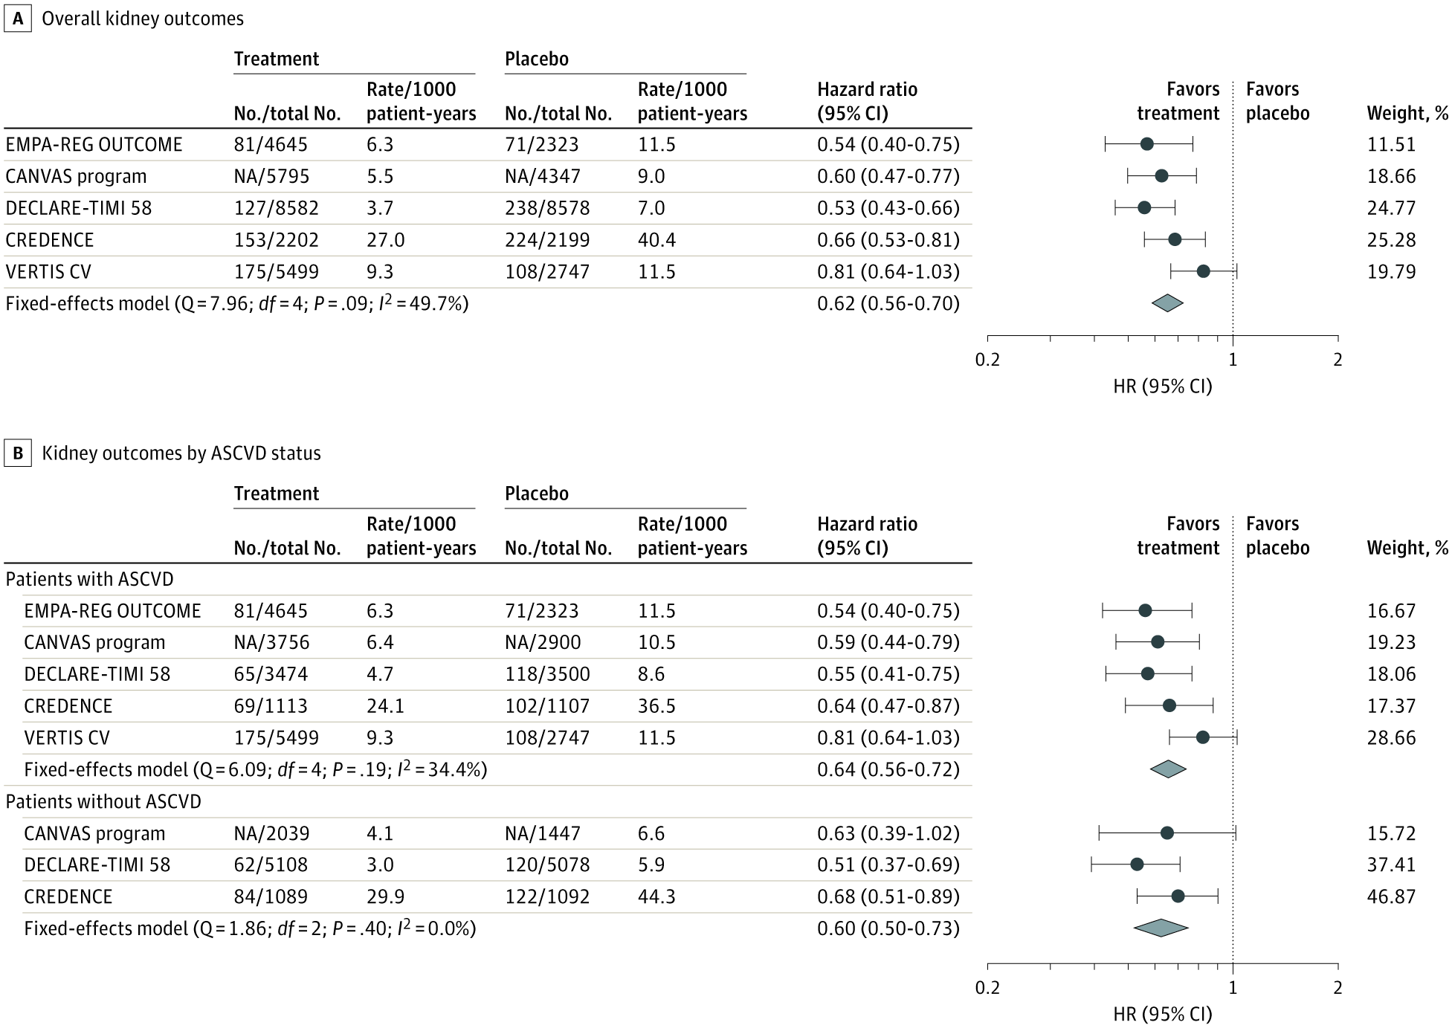
Effect on MACE
Effect on KIDNEY
ESC Guidelines 2023
McGuire et al JAMA Cardiol

Slide 8
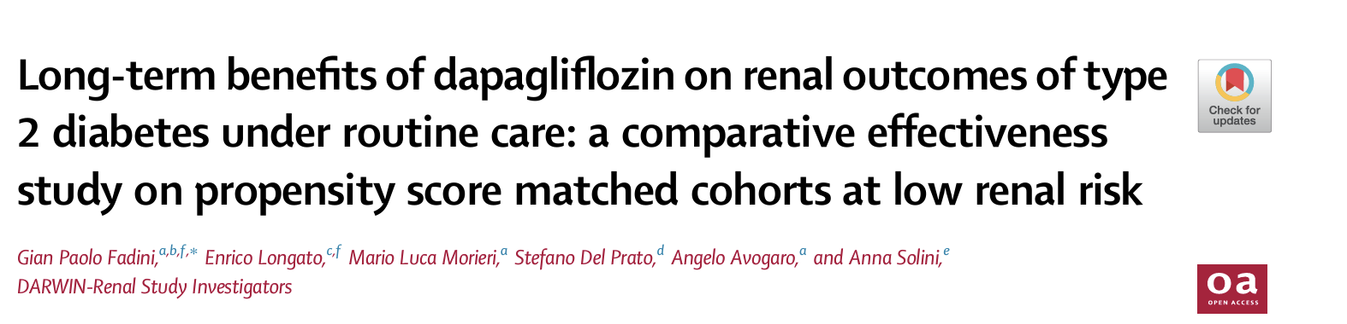
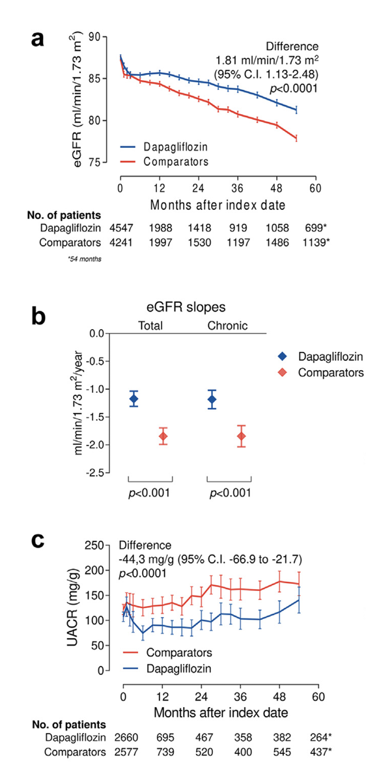

Slide 9
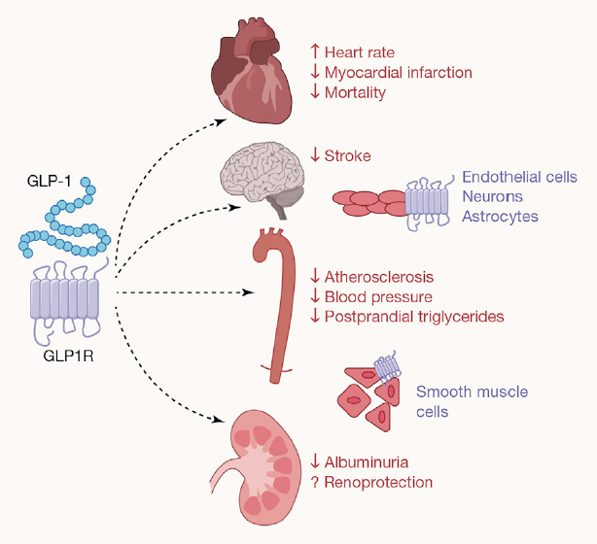
GLP-1 MoA
Cherney et al. Med 2021

Slide 10
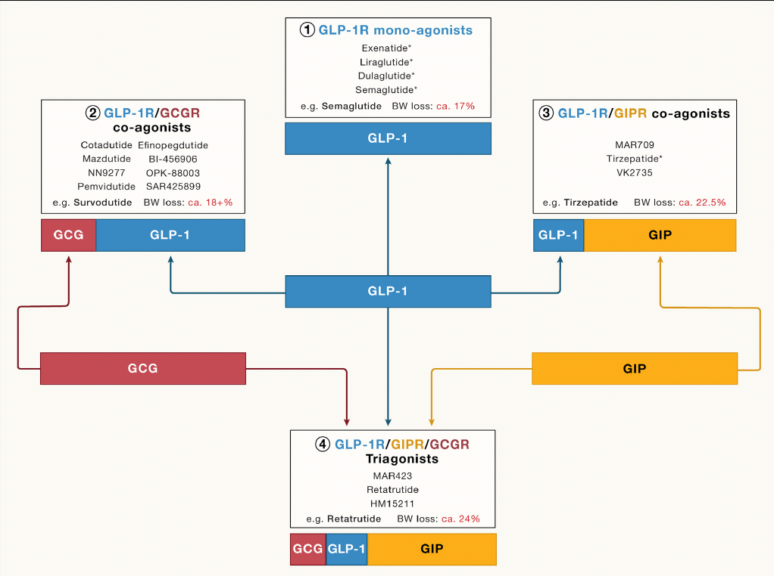
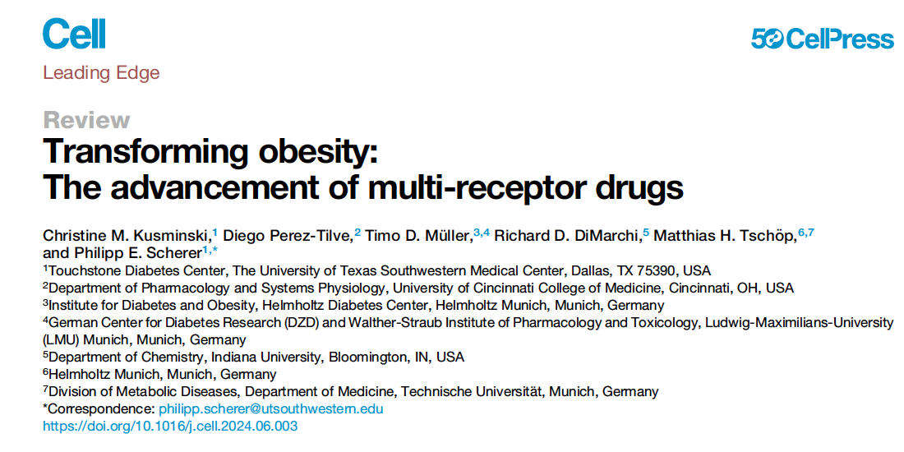

Slide 11
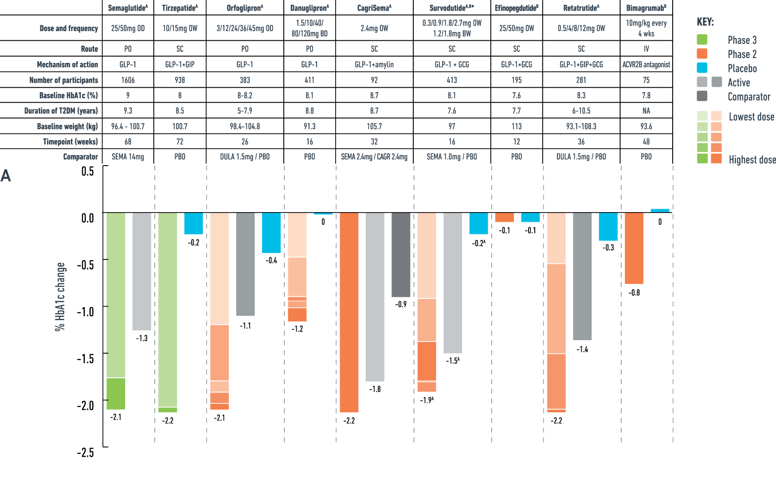
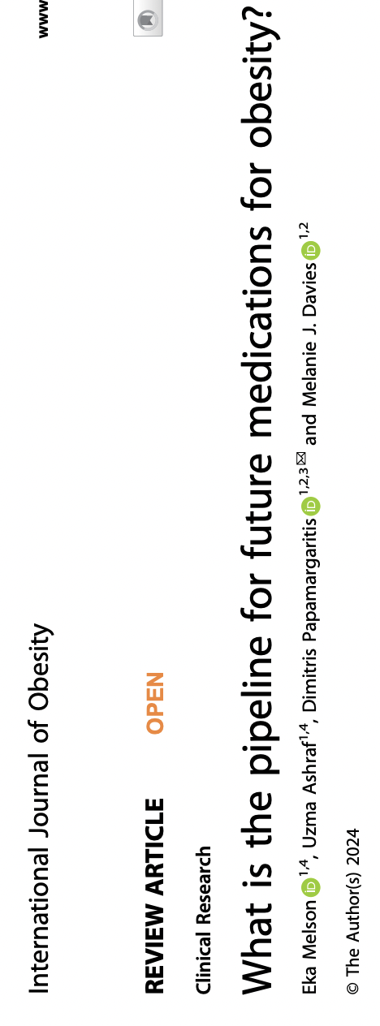

Slide 12
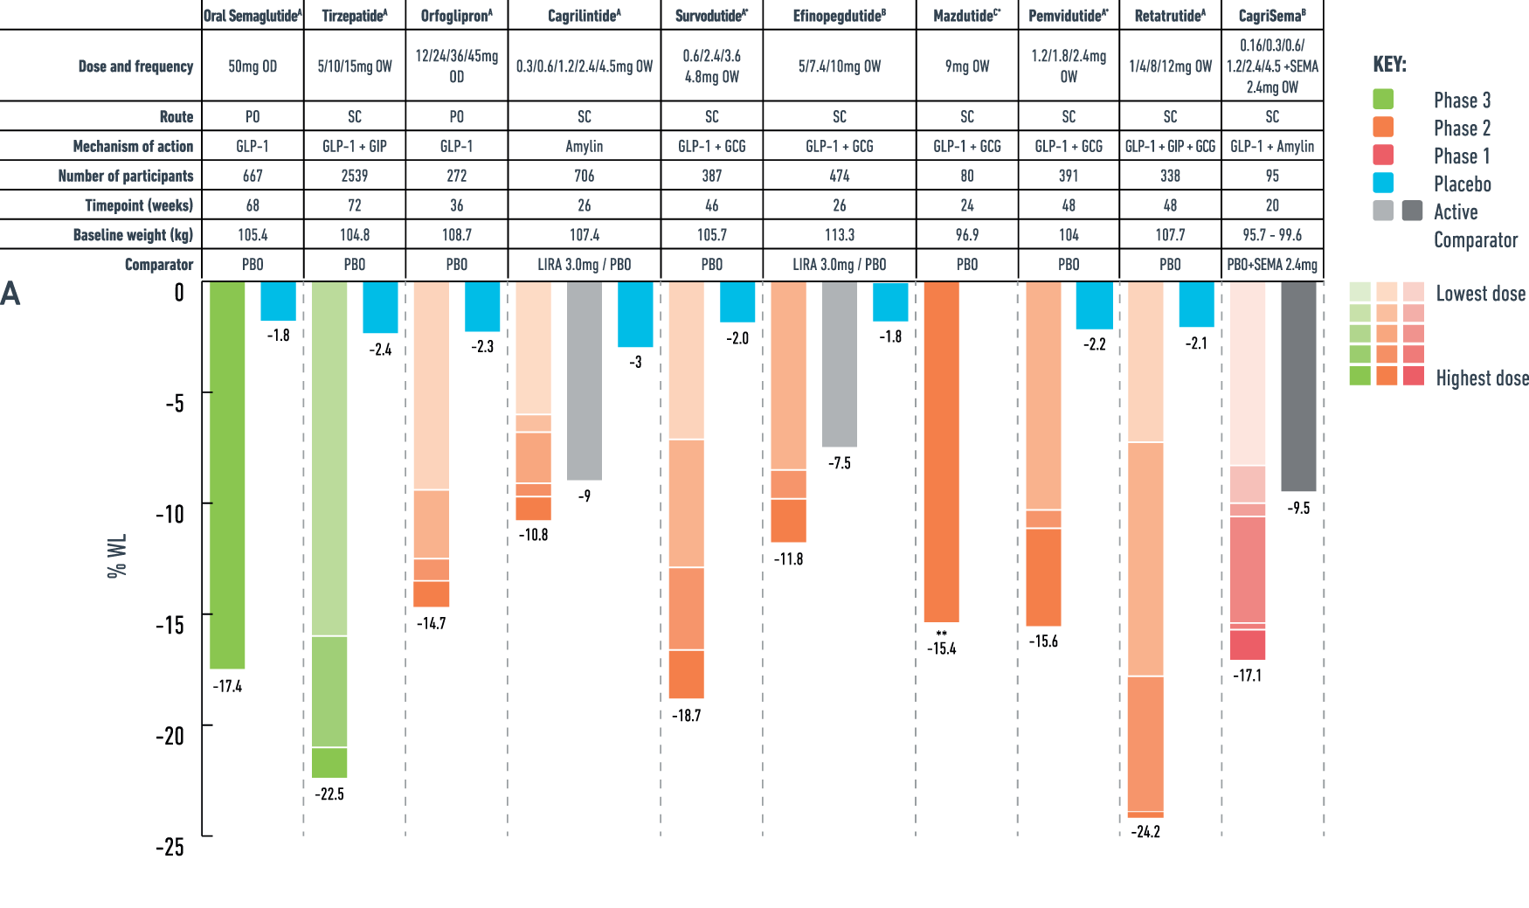

Slide 13
Incretins improve the Digestion/Oxidation coupling
DIGESTION
↓ inflammation
↓ VSMC proliferation
↓ Platelets activation
↑ AT blood flow
INCRETINS
PERFUSION
INSULIN
↑Nitric oxide
↑ capillary recruitment
↓ Platelets activation
OXIDATION/STORAGE
Avogaro et al. Submitted

Slide 14
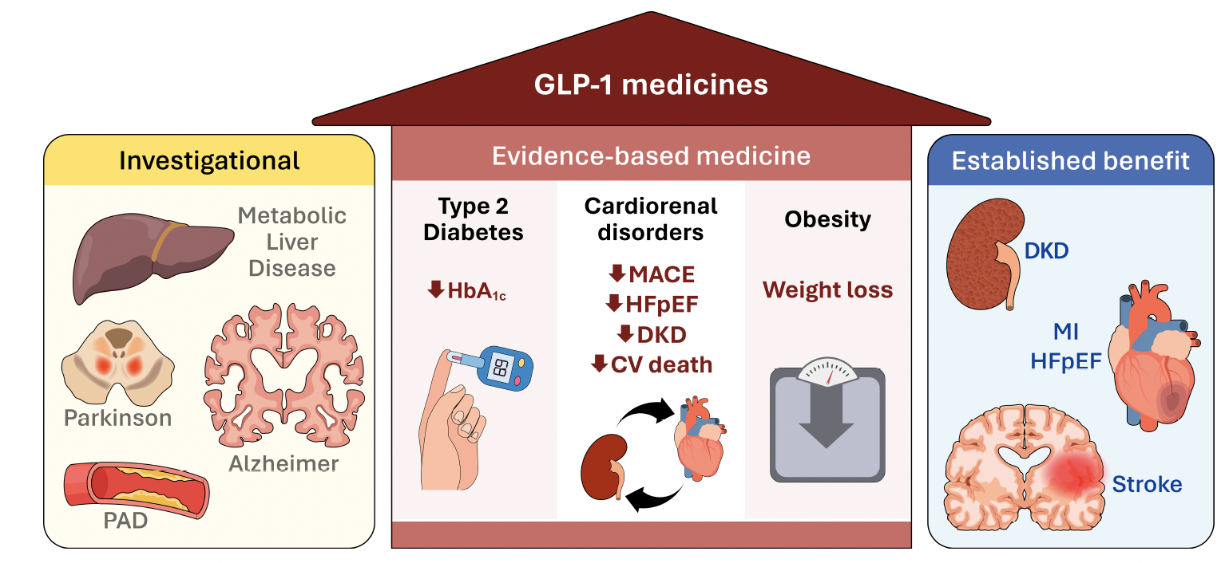
Established and emerging evidence supporting use of GLP-1 medicines
Drucker Diabetes Care 2024

Slide 15
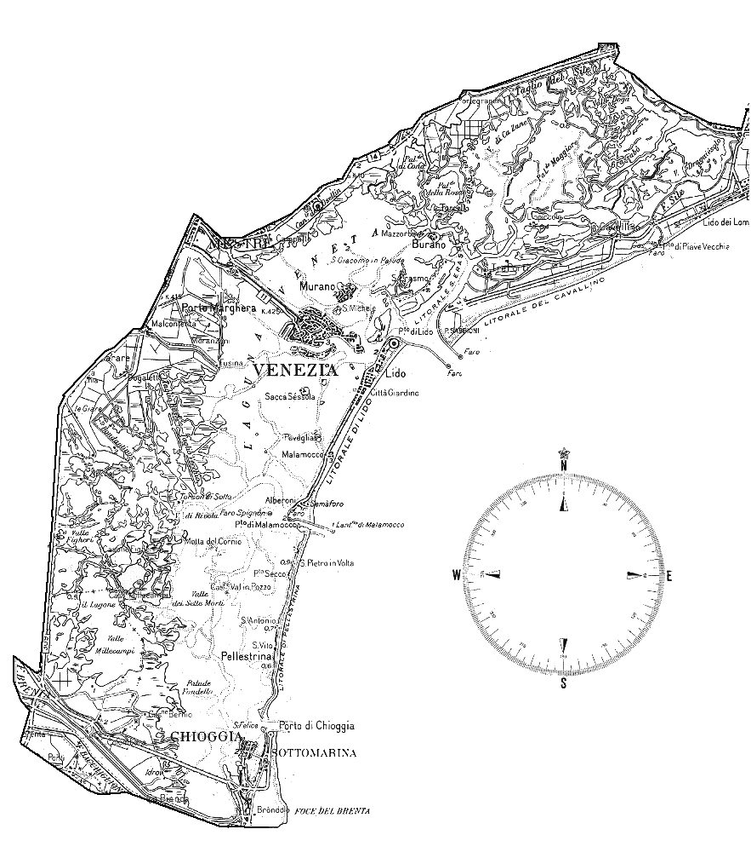
GLP-1RA /SGLT2i
HYPERGLYCEMIA

Slide 16
Summary: The landscape of diabetes treatment is rapidly evolving, with pharmacological advancements offering promising avenues for improved patient outcomes
Call to Action: Continued investment in research and personalized care approaches is essential to combat the global diabetes epidemic.

